Slide 1


Sophie Hubert
Ironhack- Data Analyst - Remote/part-time
June 21- Nov 21
Book Recommendation System
Final Project

Slide 2
01
02
03
Data cleaning:
- Books
- Users
- Ratings
Exploratory analysis
Recommendation
System
04
05
Tableau
Conclusion
Summary
What are we going to talk about

Slide 3

The Project:
Creation of a book recommendation system.
Recommender systems have become a part of our daily life . While some sites might use those systems to improve the customer experience or increase sales , others are focused on customized advertising and suggestive marketing.
As a book lover, I have always wondered where I can find good book recommendations .

Slide 4

About the dataset
Kaggle
The dataset used for this project was sourced from Kaggle.
This website allows users to find and publish data sets, explore and build models in a web-based data-science environment, and work with other data scientists.
While there are many book datasets available to use, I decided to work with amazon dataset.

Slide 5
Book recommendation system
Data cleanning
Approch
It refers to preparing data for analysis by removing or modifying data that is incomplete, irrelevant, duplicated, or improperly formatted.
Files : 3 data cleaning jupyter notebook, one for each csv files.
Exploratory analysis
In statistics, exploratory data analysis is an approach of analyzing data sets to summarize their main characteristics, often using statistical graphics and other data visualization methods.
Files : EDA jupyter notebook.
Recommendation system
- Simple recommenders
- Collaborative Filtering based Recommendation System
- User-based recommendation book system
- Collaborative Filtering Using k-Nearest Neighbors
Files: Recommendation system jupyter notebook.
Others : files 2 function.py

Slide 6





Data-Cleaning

Slide 7
Data- Cleanning
Books
Users
Ratings
Preprocessed
In this dataset the main cleaning task was to deal with the column year_of_publication which was not filed only with years, some publisher name were sitting there and data needed to be ammended.
Other than this, I have been doing the usual cleaning (titlte format, nan, dropping unecessary column such as image and url as it is not useful for our analysis.
Once done I saved this clean data in a new csv file to use it later.
Csv file users is composed of 3 column user_id, location and age.
Regarding the location, I split the column in three as it was containing cities, region/state and country.
For age Values below 5 and above 90 are not necessary in this case, so I am replacing them by NaNs and then with means.
Column location have been dropped.
Saving the data as new csv file
Rating data set has 3 column user_id, isbn and book_rating.
Here I mainly focus on book_rating once the dataset was uniformised and basic check and data cleaning was done.
Ratings dataset should only have books only which exist in our books dataset it should also only have ratings from users which exist in users dataset . And finally Consider only ratings from 1-10 and leave 0s in column bookRating.
Merged from the 3 previous file once cleaned.

Slide 8
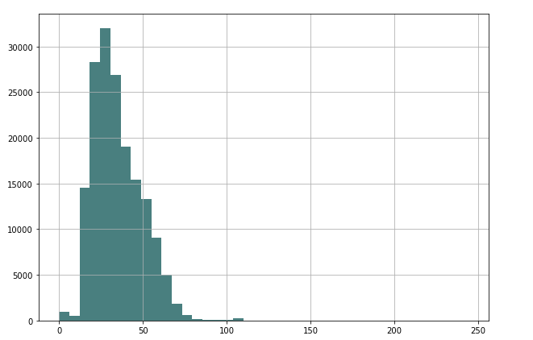
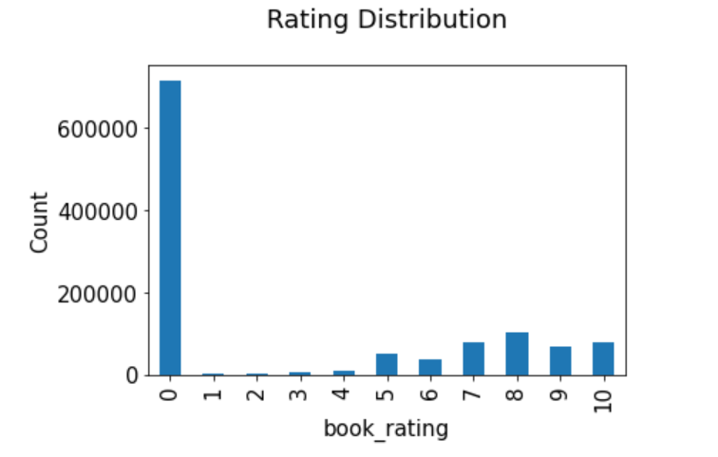
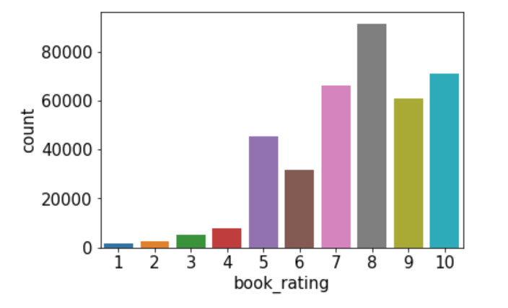
Age : As we can notice some user age were bellow 5 and above 90, which is not useful for our analysis
The highest ratings are more used and rating height is the rating mostly present.

Slide 9
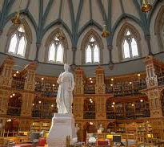
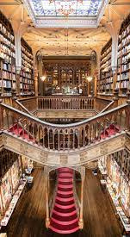
Exploratory analysis

Slide 10
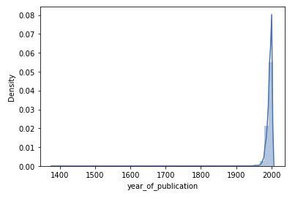
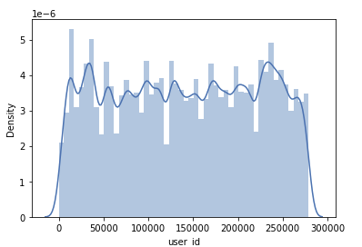
Exploratory analysis
sns.distplot

Slide 11
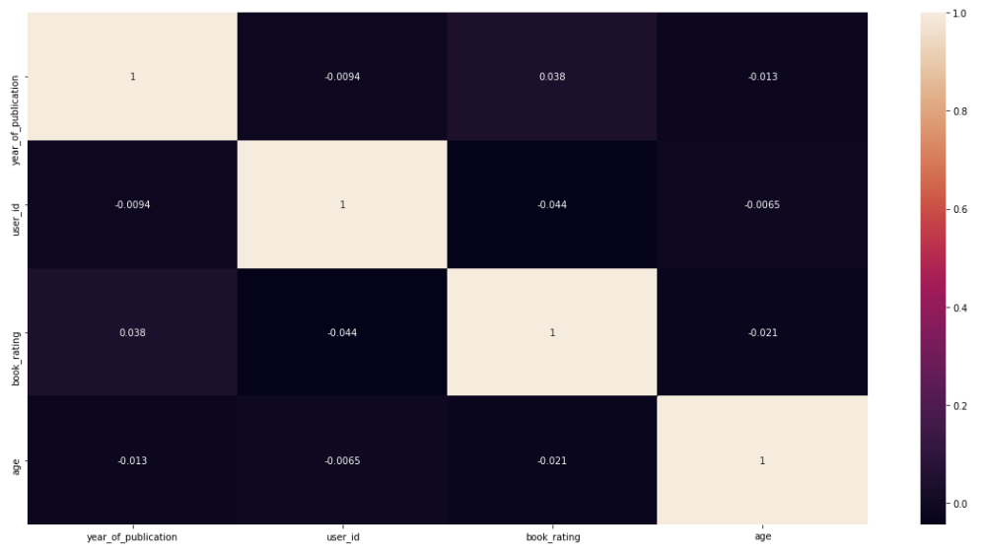

Slide 12

Recommendation
System
Simple recommenders
Collaborative Filtering based Recommendation System
User-based recommendation book system
Collaborative Filtering Using k-Nearest Neighbors

Slide 13





Recommendation system
What actually is Recommendation System A recommendation engine is a class of machine learning which offers relevant suggestions to the customer. Before the recommendation system, the major tendency to buy was to take a suggestion from friends. But Now Google knows what news you will read, Youtube knows what type of videos you will watch based on your search history, watch history, or purchase history.
A recommendation system helps an organization to create loyal customers and build trust by them desired products and services for which they came on your site. The recommendation system today are so powerful that they can handle the new customer too. They recommend the products which are currently trending or highly rated and they can also recommend the products which bring maximum profit to the company.

Slide 14
Types Of Recommendation System :
A recommendation system is usually built using techniques which are content-based filtering, collaborative filtering, and a combination of both.
Book Recommendation System: A book recommendation system is a type of recommendation system where we have to recommend similar books to the reader based on his interest. The books recommendation system is used by online websites which provide ebooks like google play books, open library, good Read’s, etc.
Collaborative Filtering
Content-Based Filtering
Hybrid Recommendation Systems
Simple recommenders:
Generalized recommendations to every user, based on book popularity and/or genre. The basic idea behind this system is that books that are more popular and critically acclaimed will have a higher probability of being liked by the average audience.

Slide 15
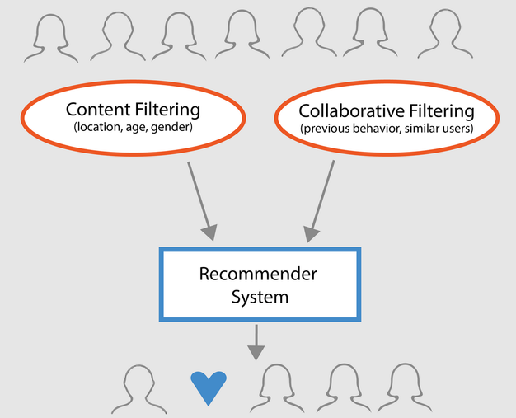
Collaborative Filtering:
This filtering method is usually based on collecting and analyzing information on user’s behaviors, their activities or preferences, and predicting what they will like based on the similarity with other users. A key advantage of the collaborative filtering approach is that it does not rely on machine analyzable content and thus it is capable of accurately recommending complex items such as movies without requiring an “understanding” of the item itself.
Collaborative based filtering recommender systems are based on past interactions of users and target items. In simple words here, we try to search for the look-alike customers and offer products based on what his or her lookalike has chosen.
Exemple : Youtube
Collaborative-based Filtering :
Content-Based Filtering
The algorithm recommends a product that is similar to those which used as watched. In simple words, In this algorithm, we try to find item which look alike (similar ages, categories ...).
it only looked at the similarity between the content and does not focus on the person who is reading it. this system recommends the book which has the highest score based on past preferences.

Slide 16
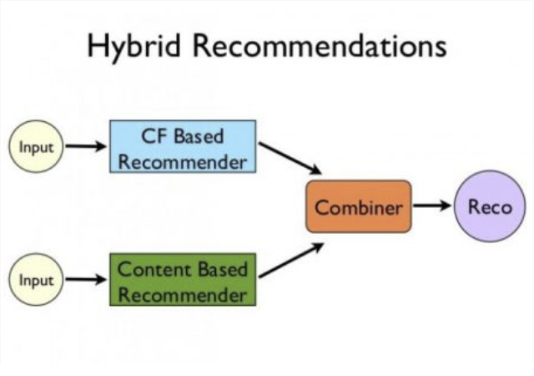
Hybrid Filtering Method :
It is basically a combination of both of the above methods. It is a too complex model which recommends product based on your history as well as based on similar users.

Slide 17
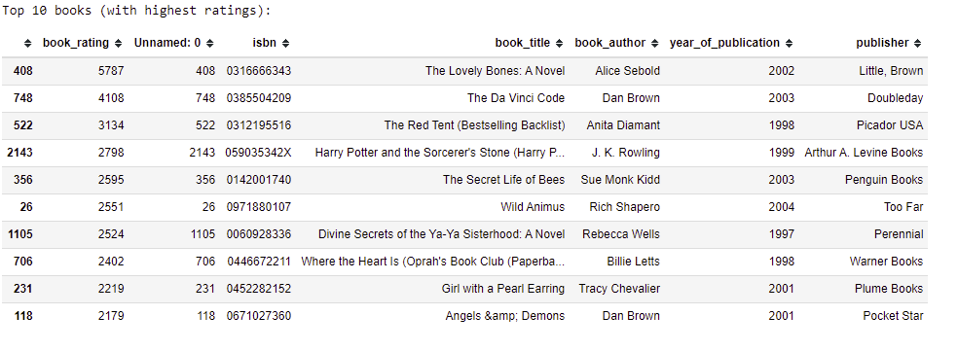
Simple Popularity based Recommendation System :
Recommendations based on ratings

Slide 18
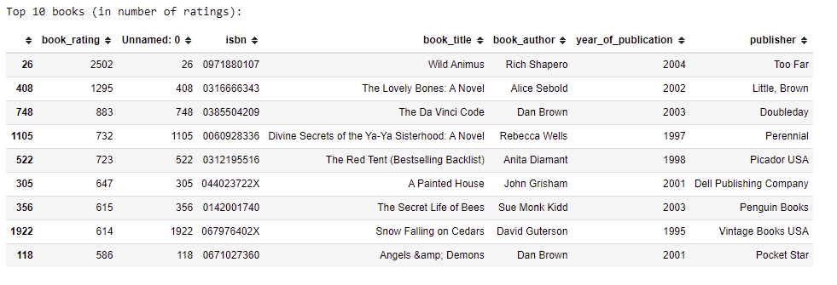
Recommendation based on popularity

Slide 19
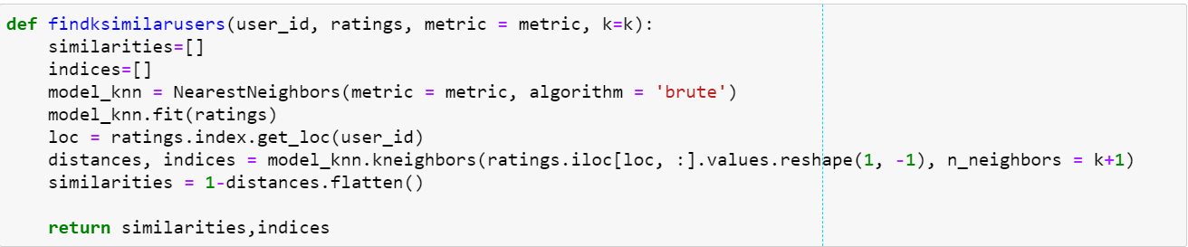
User-based recommendation book system:
The function findksimilarusers inputs user_id and ratings matrix and returns similarities and indices of k similar users.
The function predict_userbased predicts rating for specified user-item combination based on user-based approach..
Use any user from the list that we are getting.
The following function utilises above functions to recommend items for item/user based approach and cosine/correlation. Recommendations are made if the predicted rating for an item is >= to 6,and the items have not been rated already
Checking for incorrect entries and getting the list User id that should be a valid integer .

Slide 20
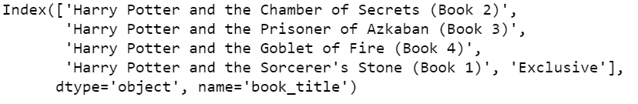
Collaborative Filtering Using k-Nearest Neighbors (kNN)
Collaborative Filtering Using k-Nearest Neighbors (kNN) kNN is a machine learning algorithm to find clusters of similar users based on common book ratings, and make predictions using the average rating of top-k nearest neighbors.

Slide 21
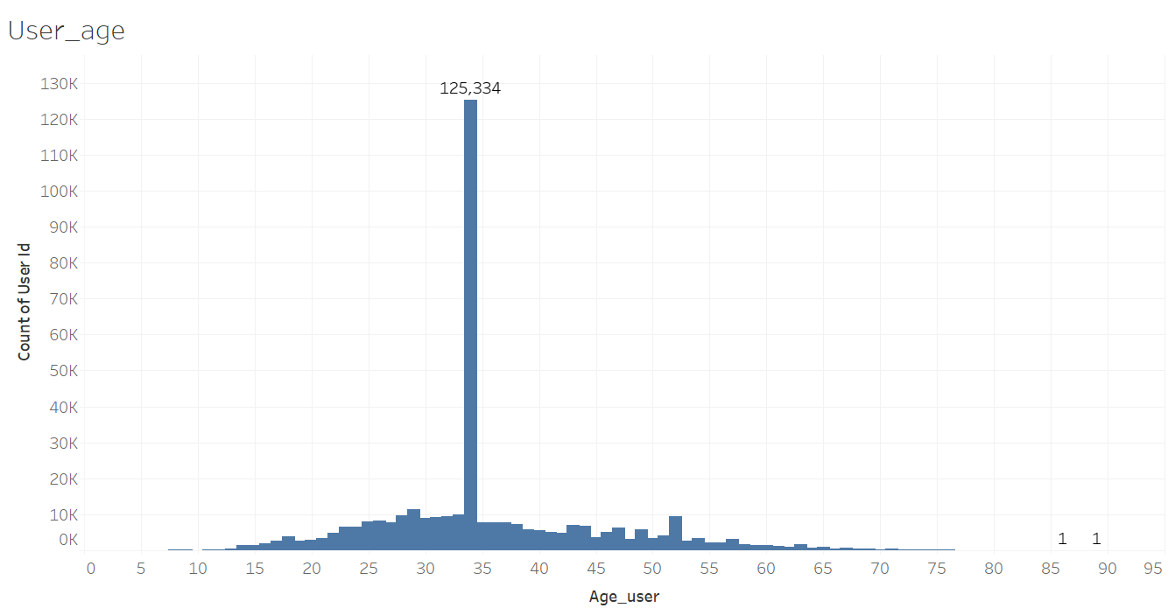
Tableau
Visualisation of the dataset : preprocessed.csv

Slide 22
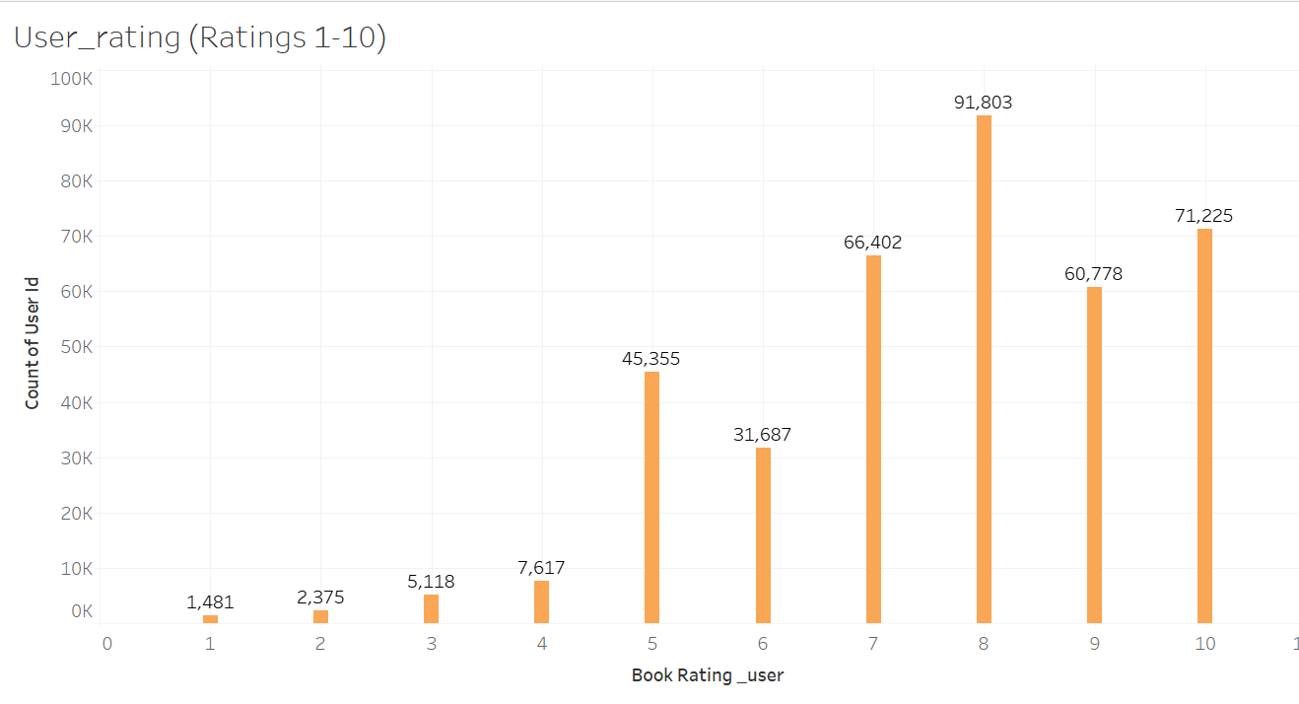
User_rating :

Slide 23
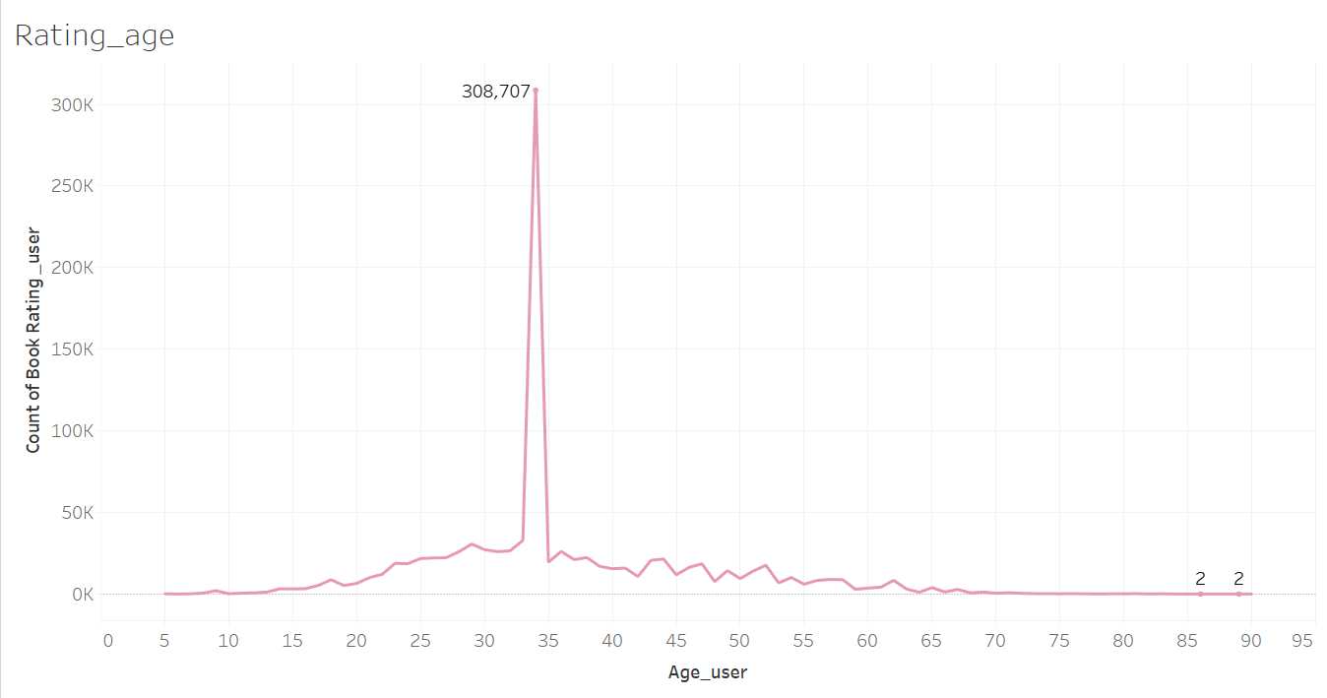
Ratings User/age :

Slide 24
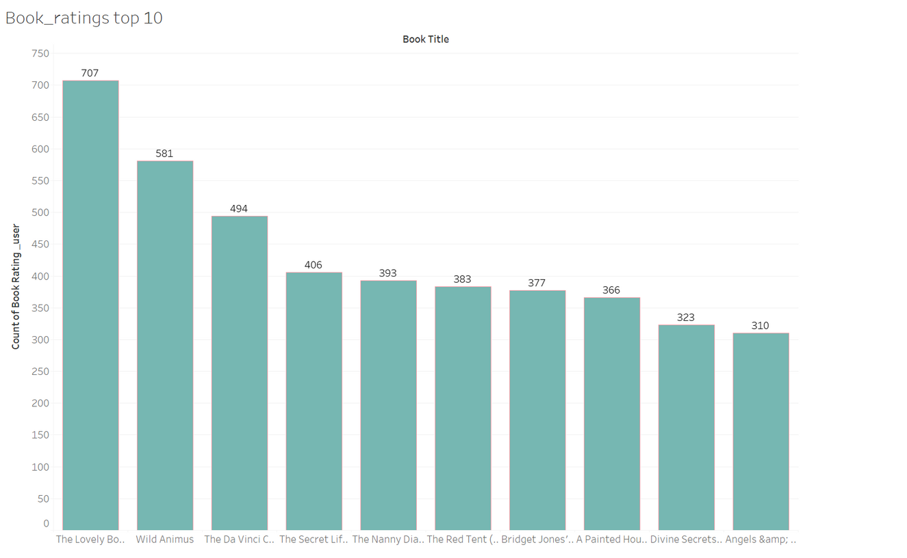
Top 10 books :

Slide 25
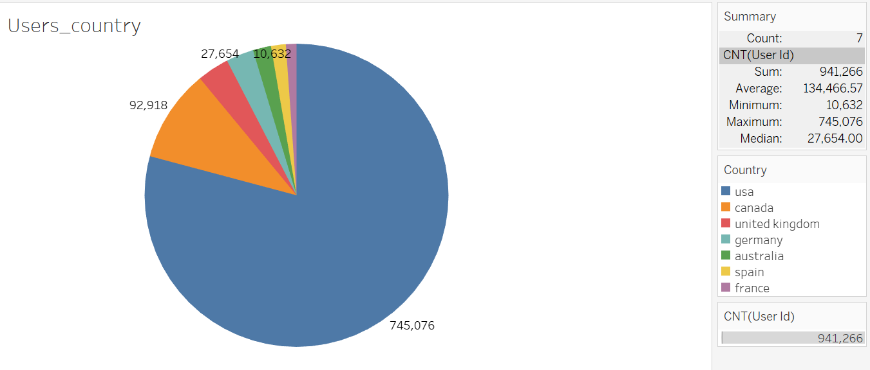
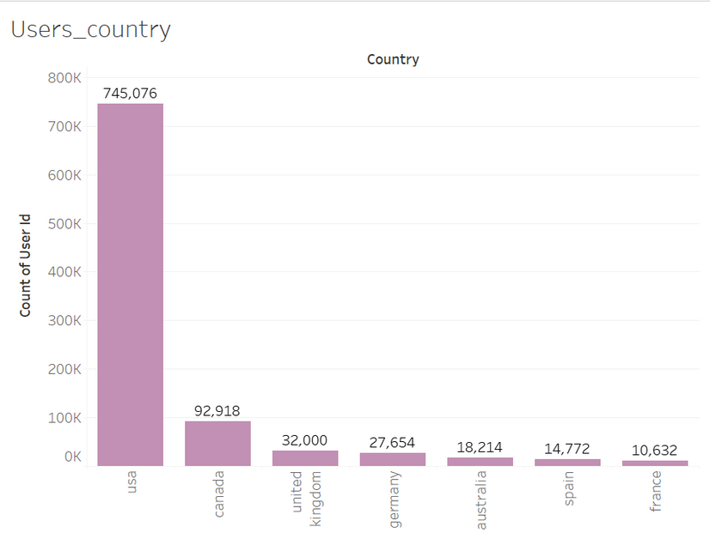
Users per country

Slide 26
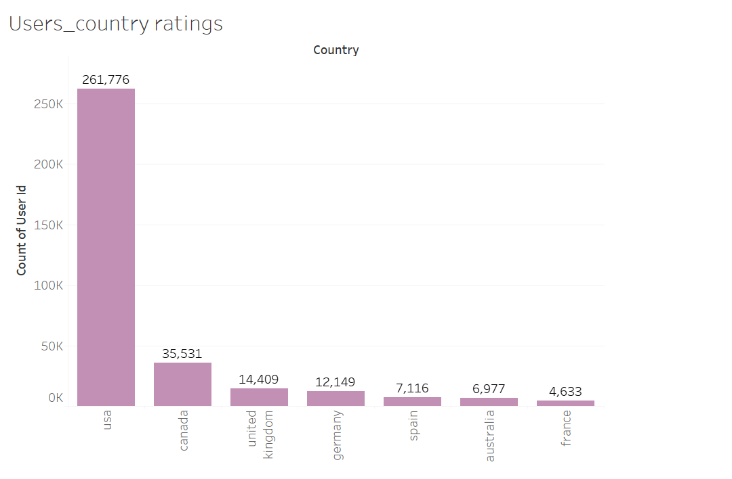
Ratings per country :

Slide 27
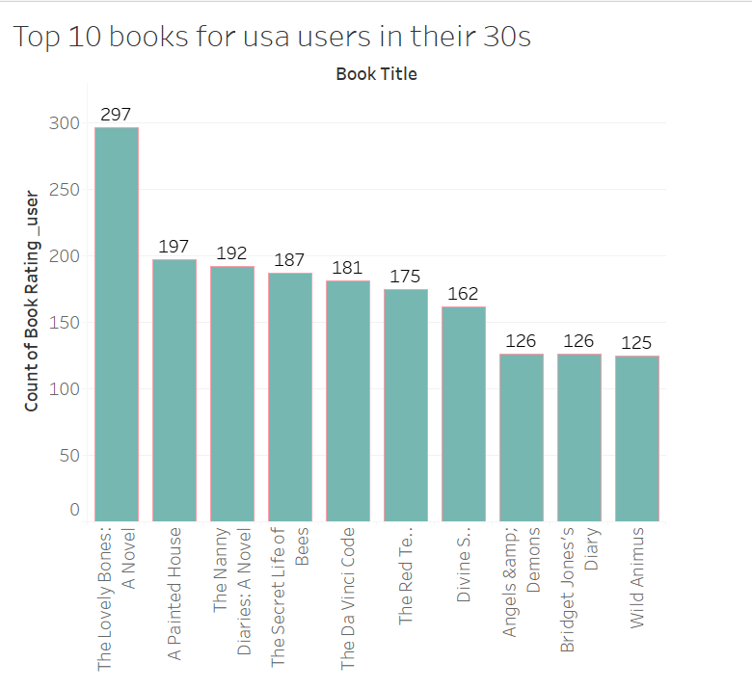
Top 10 books for american users in theirs 30s

Slide 28
Conclusion :
For this project I tried to use different approch for the book recommendation. As we can see depending on the one we choose recommended books are not the same, and the complexity of the system is different.
Now I have a better understanding of what youtube , netflix ... are recommended me and why.
Over all, I felt like this was a good choice for a project. The problem was interesting to me and also advanced enough to challenge me to learn more about data cleaning, how to deal with a data set and machine learning algorithms used in recommendation engines.
The datasets involved some preparation and cleaning, and more time could have been spent on it, like for exemple country cleanning and potentially states as USA is where most users are from . Also it would have been great to add a columnn for categories of books .
This project allowed me to improve my Python skills and learned how to use several packages that were new to me .

Slide 29
https://github.com/SophieHubert/Recommended-Reading.git
Sophie Hubert
Thank
you !

